Slide 1
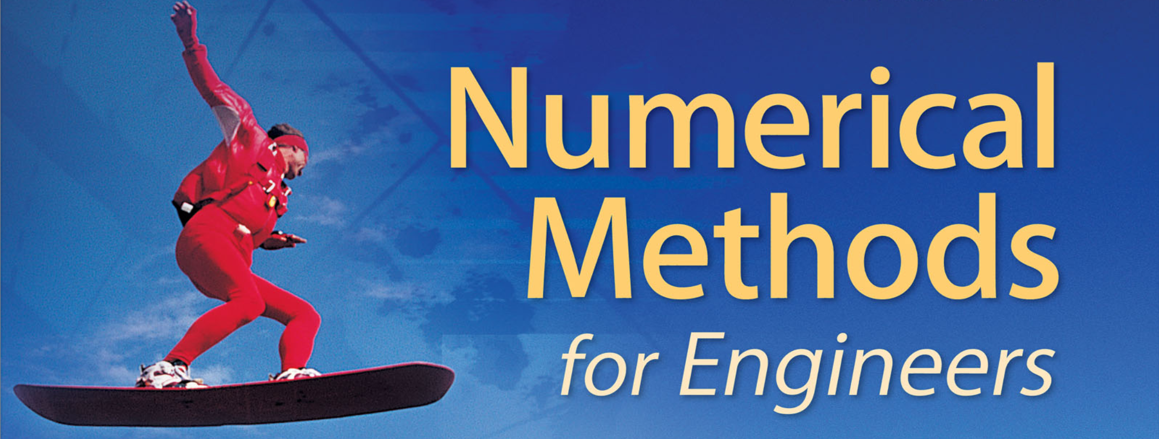
MATH 2059 Numerical Methods
Week 1
Introduction
Mathematical Modeling
MATLAB

Slide 2
Preliminaries
Class schedule: | Tuesday 10:30 – 12:30 (M1.Z06) Thursday 13:00 – 14:00 (M2.Z11)
Instructor: | Dr. Kamil Erdayandı, kamil.erdayandi@marmara.edu.tr Office: M2-232, Phone: (216) 777 3535
TA: | Eda Patoğlu eda.patoglu@marmara.edu.tr

Slide 3
Preliminaries
Attendance: | Classroom attendance (%70) is mandatory.
Quizzes: | There will be three quizzes.
Homework(s): | There may be some homework.
P.S. | There may be problem sessions before the exams.

Slide 4
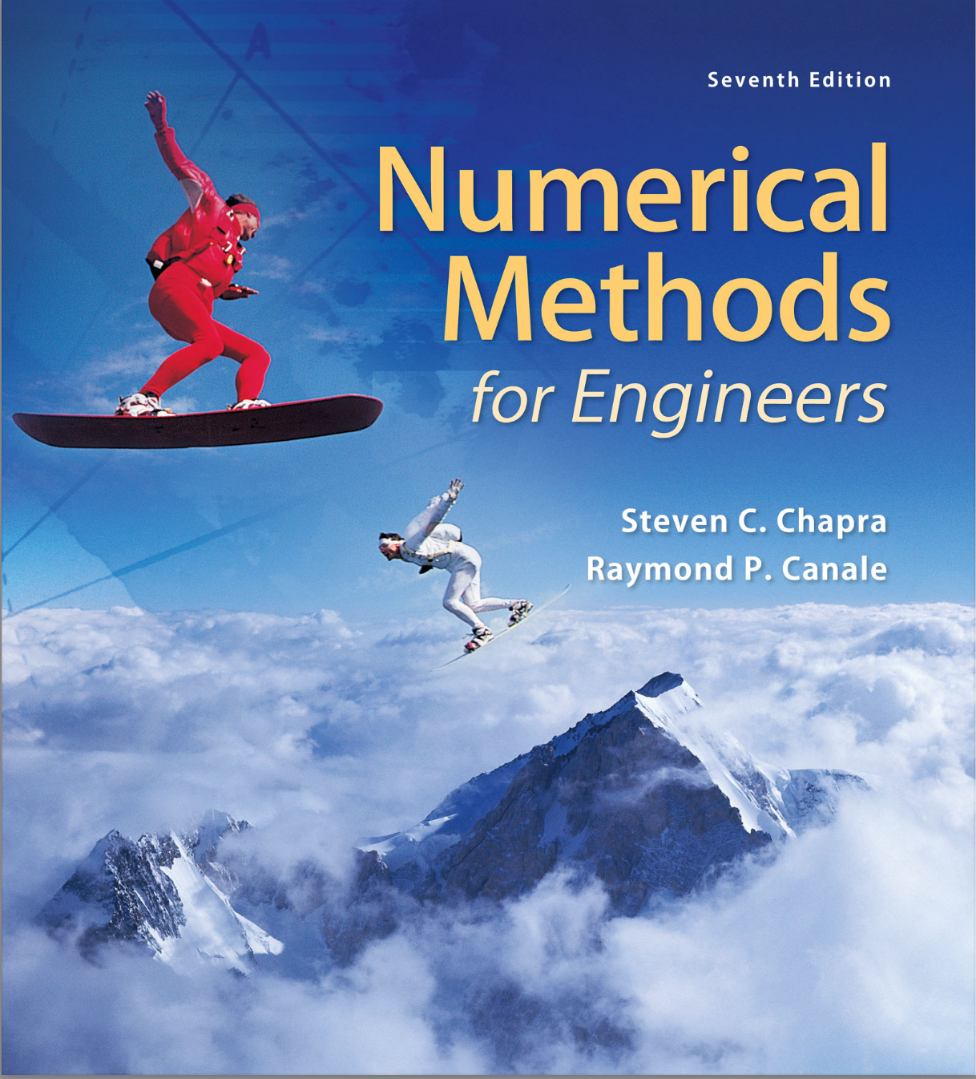
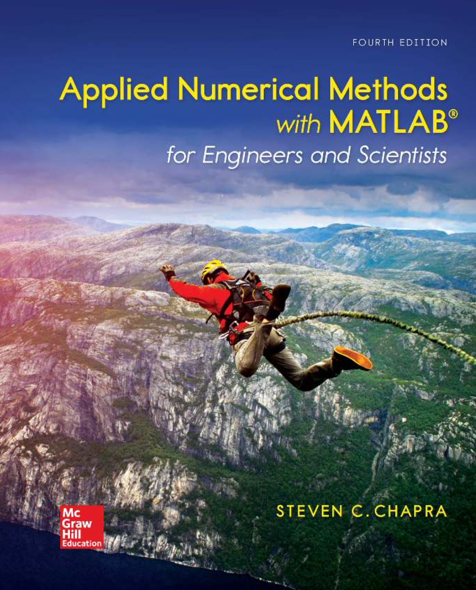
Recommended textbooks

Slide 5
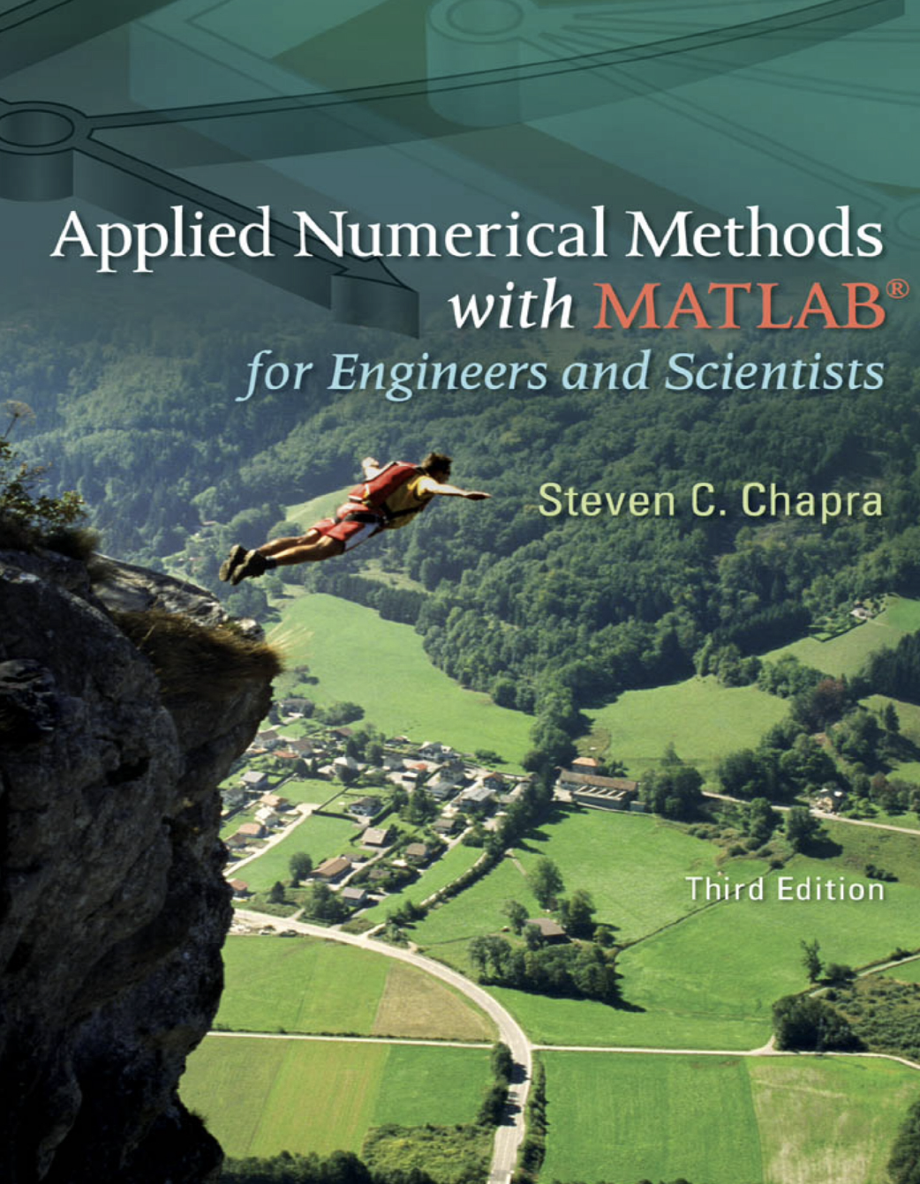
Alternatively

Slide 6
Syllabus
Grading:
 | Quizzes | 15%
 | HW | (N_{H} x 5) %
 | Midterm | 45 - (N_{H} x 5) %
 | Comprehensive Final | 40% N_{H} : Number of homework assignments.

Slide 7
Course Objectives
Introduce: Basic numerical methods and Their applications in engineering

Slide 8
Learning Outcomes
Learning Objective 1:
  Use the MATLAB programming language and toolboxes to implement numerical algorithms.
Learning Objective 2:
  Solve nonlinear equations with a single unknown using numerical methods.
Learning Objective 3:
  Solve systems of linear equations using numerical methods.

Slide 9
Learning Outcomes
Learning Objective 4:
  Apply basic principles of optimization using numerical methods.
Learning Objective 5:
  Apply interpolation and regression to fit a curve to data obtained in engineering applications.
Learning Objective 6:
  Apply numerical methods for differentiation, integration and differential equations.

Slide 10
MATLAB
Web Page: www.mathworks.com
You can install to your PC:
  Create an account using your Marmara University e-mail address.
  Install MATLAB (with all toolboxes)
  You can also use MATLAB online.

Slide 11
MATLAB
Tutorials
  Open an account at: www.mathworks.com
  Go to MATLAB Academy: https://matlabacademy.mathworks.com/
  Enroll in the self-paced interactive course (takes 2 hours to complete):
    MATLAB Onramp (free course)

